Slide 1
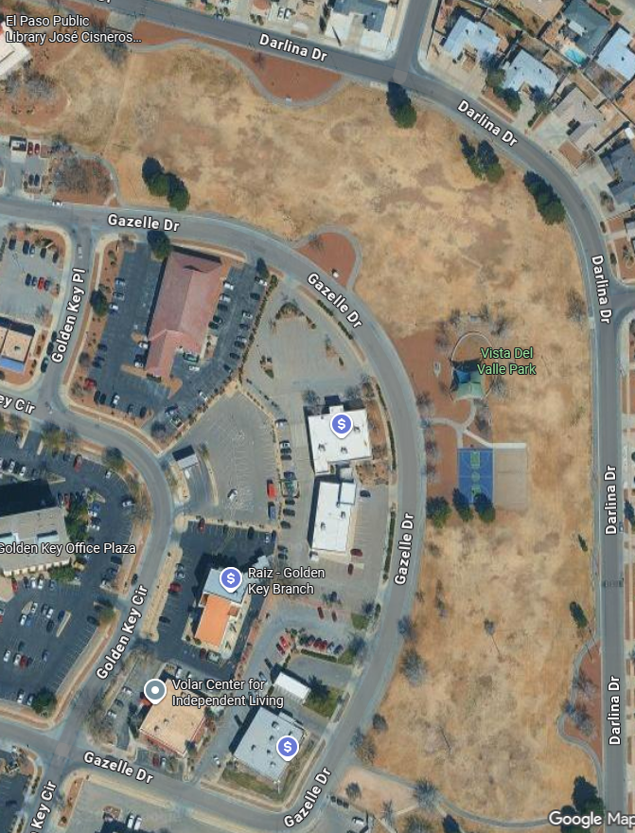
2025 Immanuel Invite Course Map

Slide 2
Coach/Spectator Map

